Slide 1
DPSIMS Private Beta Commencement
Feb 2019

Slide 2
Agenda
Purpose of Private Beta
Update and Timelines
User Research schedule, including site visits and participation
Using Online Recording Forms
Your data continuity preferences within Private Beta
LRMS users
How to raise questions with us
AOB

Slide 3
Purpose of Private Beta
Private Beta is an opportunity for us to learn from you about the service we’re creating, and to demonstrate to GDS what we’ve done with that learning.
Key things we want to understand are:
How well do frontline staff understand the new questions?
What do they make of the length of the process? Does it take a reasonable amount of time?
How easy is it for users to access the system?
How does this all feel for someone who uses the system relatively infrequently? (i.e. not Risk Managers etc who’s day job will be to get to know the ins and outs – how is it for someone who may only see it once a month or once a year?)
This means its really important that frontline, patient-facing, or clinical staff get using the new tools, and give us their feedback.
We can then evolve the service in response.

Slide 4
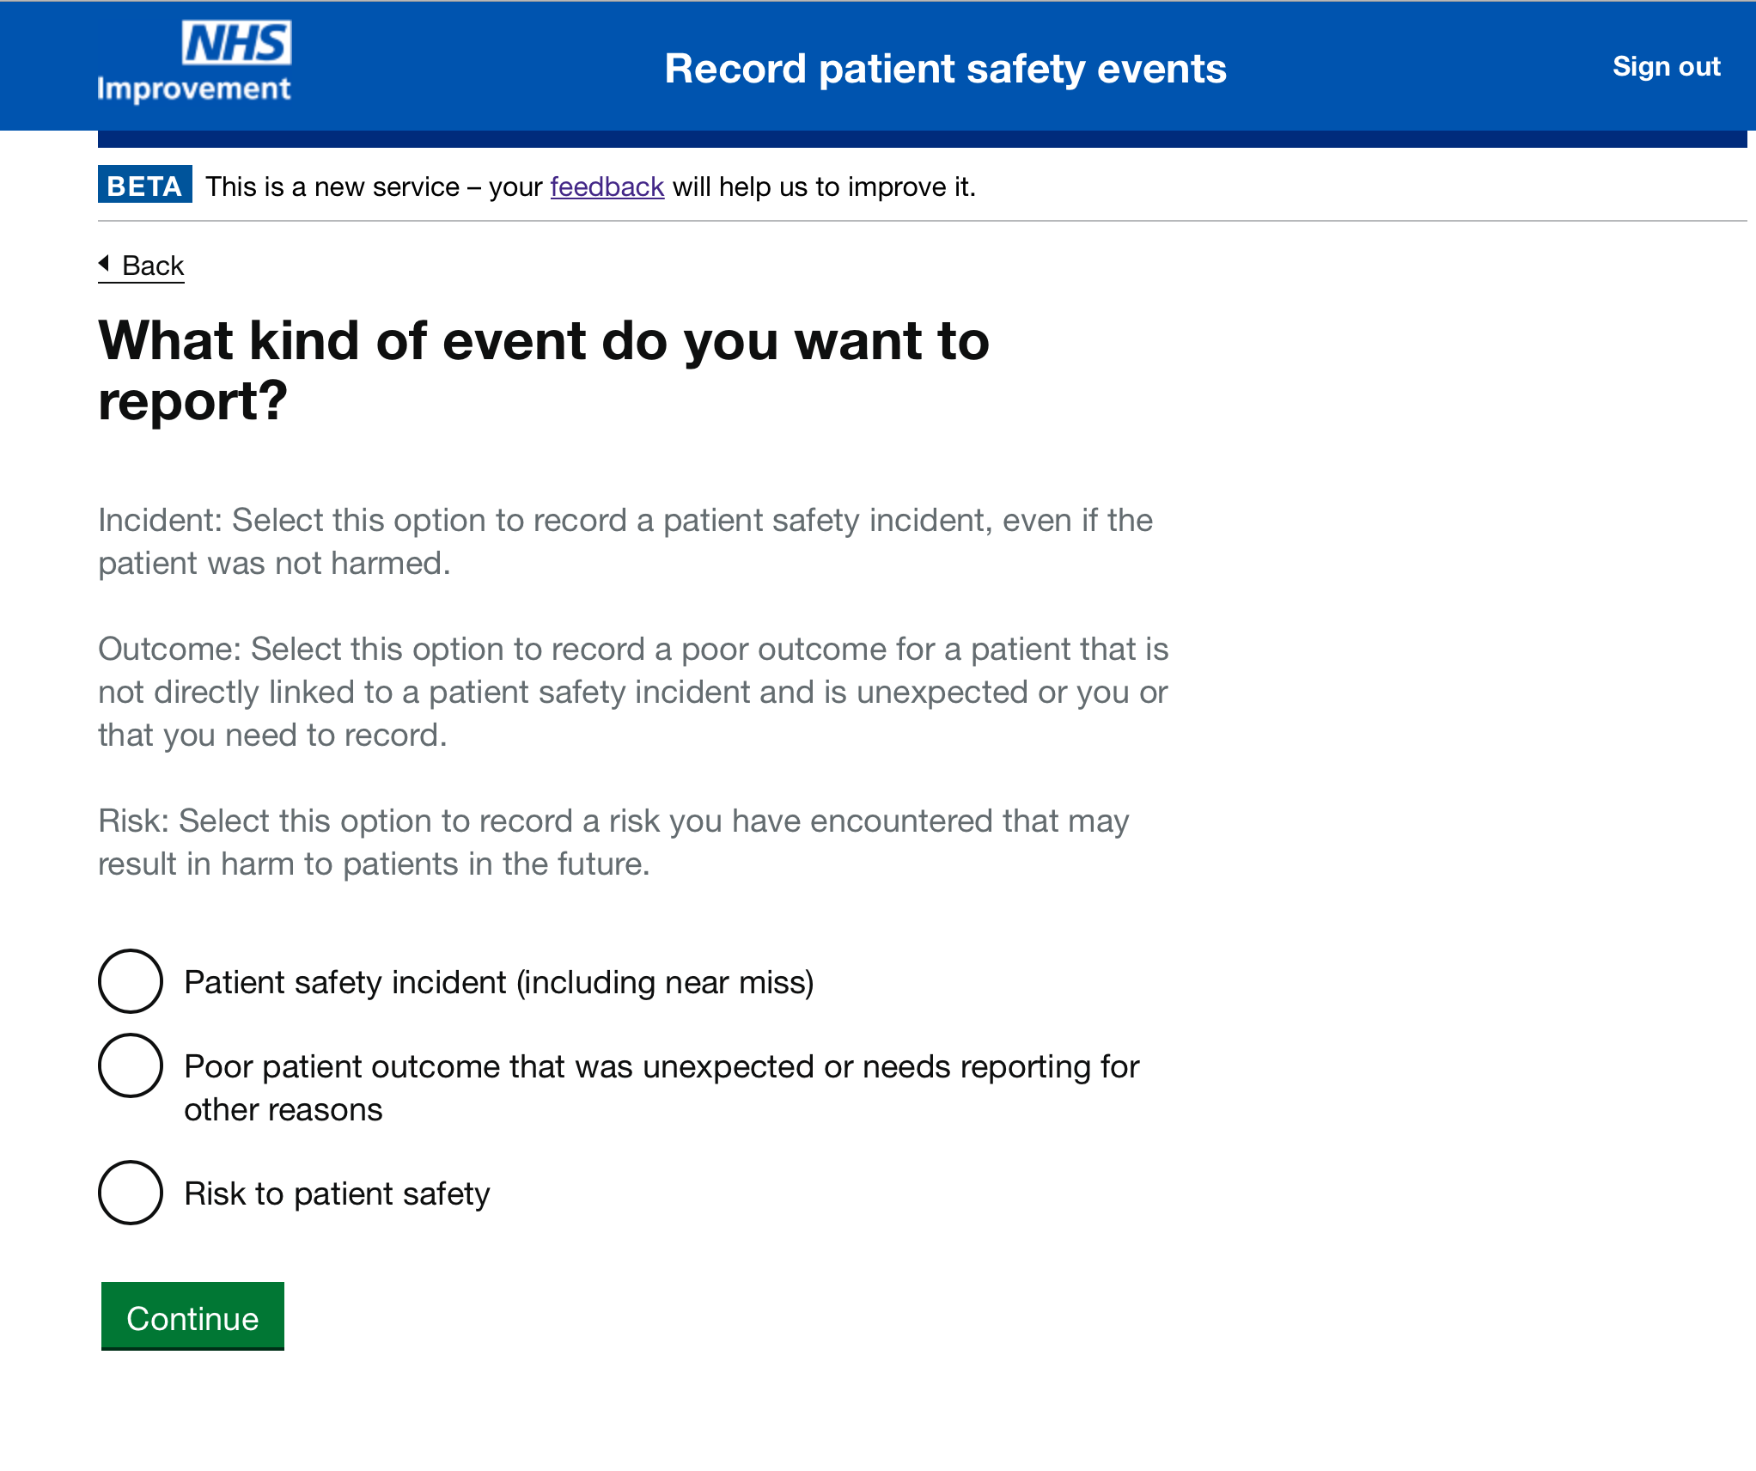
Update and timelines
The online forms are available this sprint, in a read-only/orientation format and we can send you the link to start exploring them at your own pace
http://beta.patientsafety.nhs.uk
In parallel, the forms are in the process of being quality assured (“user acceptance testing” by NHSI’s Tech and Data team) – this should be before 15th Feb, but please be aware may result in some minor changes (e.g. wording)
By the end of next sprint, all the back-end “plumbing” is expected to be complete, so from then on you can use them to submit real data, which will land securely in our servers – we anticipate this being from 28th Feb, but will keep you informed!

Slide 5
User Research
Some questions:
Who will be recording incidents within your organisation? (We need as many “typical” day-to-day reporters as possible, in order to make it a fair test of the tools)
Can we set a date with you for an on-site visit?
What will the on-site visit look like? Length, location, access, availability…
Who will be available on this date, and what is the best way for us to get to speak to frontline staff/patient-facing, incident reordering users?
Once this is established, we can set up the regular User Research sessions to collect your and other staff’s feedback

Slide 6
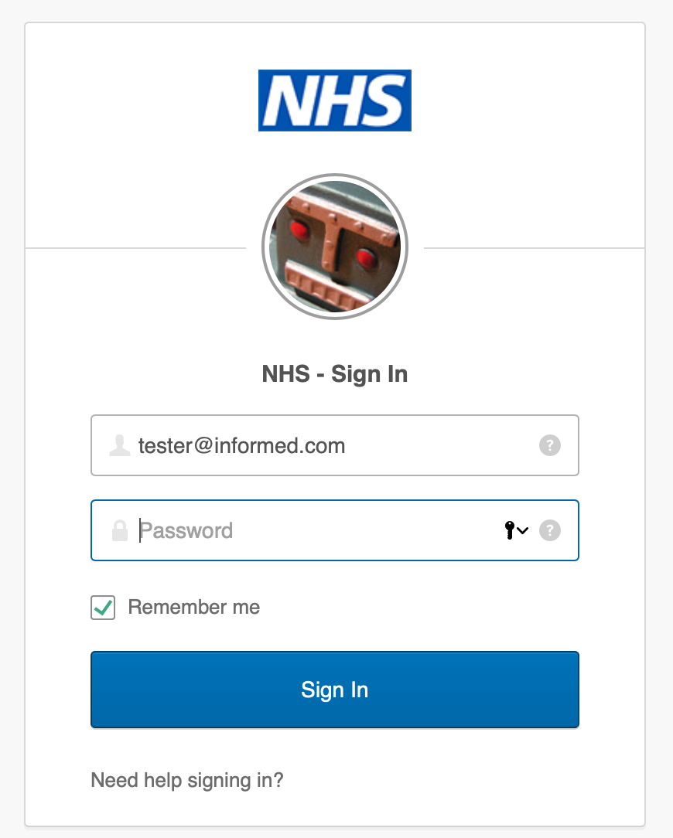
Online Incident Recording forms
If you intend to mainly use OIR forms (i.e. you don’t have a risk management system that has been made PSIMS-compatible)
Every person who’ll be using the tools will need to register via OKTA
We can get this started before the forms are live for data-collection, so you’re ready to go
Please encourage users to respond to the very quick survey after submitting a record
If you also have a LRMS:
What is your preference for duplicate-reporting during
Private Beta?
This is not a Private Beta requirement, but understand
you may need this for local processes
If you do, you can maintain NRLS data continuity

Slide 7
LRMS users
When do you think you’ll be ready to start submitting data?
We have expected test data timelines from the vendors, but this does not include sign-off or moving from test data to real data

Slide 8
How to feed back or ask questions
FAQS and background details are available on the Private Beta wiki:
https://github.com/InformedSolutions/NHSI-DPSIMS-Private-Beta/wiki/DPSIM-Private-Beta-FAQs
Please join in as many scheduled User Research sessions as possible
Please contact us on: nhsi.dpsimspilotqueries@nhs.net if you have specific or urgent questions
Please fill in online surveys when using the tools if you think of any other general feedback, things that can wait, or are about specific bits of functionality/ questions/ wording etc on the forms

